Slide 1
HOW DO COMPUTERS SEE?

Slide 2
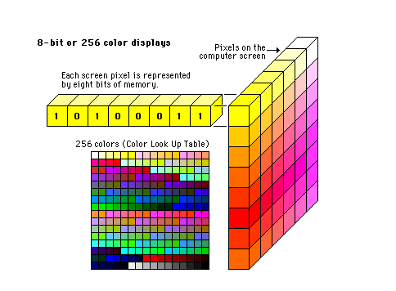
A. Represent colors by numbers:

Slide 3
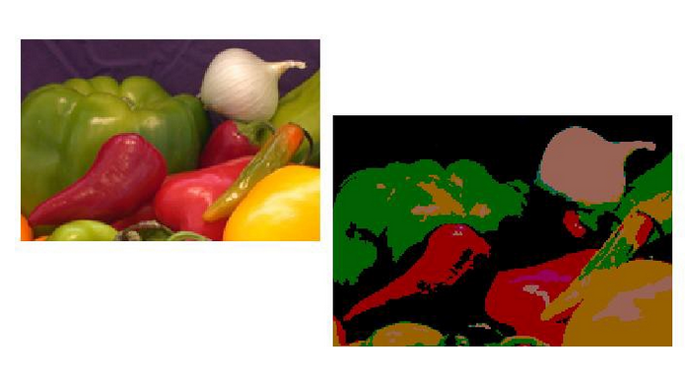
B. Image Segmentation

Slide 4
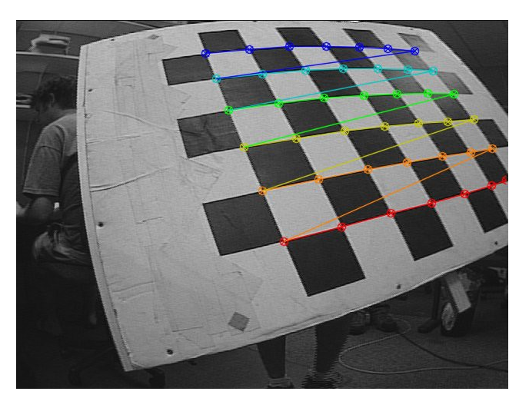
C. Finding corners

Slide 5
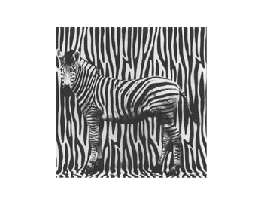
D. Find textures

Slide 6
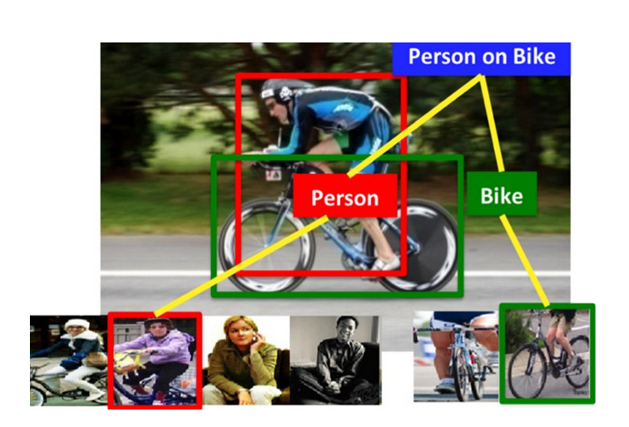
E. Make a guess

Slide 7
F. Finally, see the bigger picture!

